Slide 1
IP Telephony
2020

Slide 2
IP Telephony Applications
Integration of data, voice and fax
single network saves cost
Multiple sound quality levels
higher or lower than telephone
Video telephony
Unified Messaging
Web-based calling (click-to-call)
Low-cost voice calls

Slide 3
IP Telephony Applications (cont.)
Real-time billing
Remote teleworking
Enhanced Teleconferencing

Slide 4
Components of a VoIP Network
IP Network
Carries both media (voice) and signalling
End-points
Encoder
Packetiser
Call control
Independent of Call routing
Gateways
to PSTN and other networks

Slide 5
Call Control
Controlling the setting up and features of calls
Additional features such as call transfer, call forwarding and conferencing
Billing
Security and Authentication
Call control is distinct from voice transmisssion
Several VoIP call control standards

Slide 6
Session Initiation Protocol (SIP)
IETF Standard
Light-weight compared with H.323
Text-based client-server protocol
Features such as:
Call forwarding
Callee and calling number identification
Personal mobility
Caller and callee authentication
Basic Automatic Call Distribution (ACD)

Slide 7
SIP (cont.)
SIP creates, modifies and terminates sessions with one or more participants.
Session Types:
Internet multimedia conferences
Internet telephone calls
Multimedia distribution

Slide 8
Main functions
Signaling
Carry call information across network
Session Management
Control attributes of end-to-end call

Slide 9
SIP Architecture
Peer – to – Peer Protocol
Peers in a session are called User Agents (UA)
Functions of a UA
User Agent Client (UAC)
Client application that initiates SIP request
User Agent Server (UAS)
Server application which respond to SIP request
Physical Components
SIP Clients
SIP Server

Slide 10
SIP Clients
Phones
Can act as either UAC or UAS
Can initiate SIP request and respond
IP phones, Soft phones
Gateways
Provide call control
Translate between SIP end points
To PSTN for telephony interworking
To H.323 for IP Telephony interworking

Slide 11
SIP Servers
Proxy Server
Forward received SIP request
Authentication, Authorization, Routing, security
Network Access Control, Reliable retransmission
Redirect Server
Provide info. about next hop (s)
Registrar server
Register locations of UAC
Co-located with proxy & redirect Servers

Slide 12
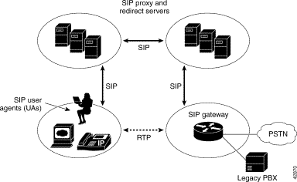
SIP Architecture …

Slide 13
How it works
Users identified by unique SIP address
sip:userid@gateway.com
UserID – username or E.164 address
sip:alan@wcom.com
sip:+1-613-555-1212@wcom.com;user=phone
Users register with registrar server
When initiating a call
SIP request Header
From : Caller Address
To : Callee Address

Slide 14
SIP Methods
INVITE Requests a session
ACK Final response to the INVITE
OPTIONS Ask for server capabilities
CANCEL Cancels a pending request
BYE Terminates a session
REGISTER Sends user’s address to server

Slide 15
SIP Responses
1XX Provisional 100 Trying
2XX Successful 200 OK
3XX Redirection 302 Moved Temporarily
4XX Client Error 404 Not Found
5XX Server Error 504 Server Time-out
6XX Global Failure 603 Decline

Slide 16
How it works …
SIP Session
SIP
User Agent
Client
SIP
User Agent
Server
INVITE sip:user@sip2.com
200 OK
ACK
Media Stream
BYE
200 OK
host.sip1.com
sip.sip2.com

Slide 17
SIP INVITE
INVITE sip:e9-airport.mit.edu SIP/2.0
From: "Dennis Baron"<sip:6172531000@mit.edu>;tag=1c41
To: sip:e9-airport.mit.edu
Call-Id: call-1096504121-2@18.10.0.79
Cseq: 1 INVITE
Contact: "Dennis Baron"<sip:6172531000@18.10.0.79>
Content-Type: application/sdp
Content-Length: 304
Accept-Language: en
Allow: INVITE, ACK, CANCEL, BYE, REFER, OPTIONS, NOTIFY, REGISTER, SUBSCRIBE
Supported: sip-cc, sip-cc-01, timer, replaces
User-Agent: Pingtel/2.1.11 (WinNT)
Date: Thu, 30 Sep 2004 00:28:42 GMT
Via: SIP/2.0/UDP 18.10.0.79

Slide 18
Session Description Protocol
IETF RFC 2327
“SDP is intended for describing multimedia sessions for the purposes of session announcement, session invitation, and other forms of multimedia session initiation.”
SDP includes:
The type of media (video, audio, etc.)
The transport protocol (RTP/UDP/IP, H.320, etc.)
The format of the media (H.261 video, MPEG video, etc.)
Information to receive those media (addresses, ports, formats and so on)

Slide 19
SDP
v=0
o=Pingtel 5 5 IN IP4 18.10.0.79
s=phone-call
c=IN IP4 18.10.0.79
t=0 0
m=audio 8766 RTP/AVP 96 97 0 8 18 98
a=rtpmap:96 eg711u/8000/1
a=rtpmap:97 eg711a/8000/1
a=rtpmap:0 pcmu/8000/1
a=rtpmap:8 pcma/8000/1
a=rtpmap:18 g729/8000/1
a=fmtp:18 annexb=no
a=rtpmap:98 telephone-event/8000/1

Slide 20
Name translation and user location
Caller only has callee's name or e-mail address.
Need to get IP address of callee’s current host:
user moves around
DHCP protocol
user has different IP devices (PC, PDA, car device)
Result can be based on:
time of day (work, home)
caller (don’t want boss to call you at home)
status of callee (calls sent to voicemail when callee is already talking to someone)
Service provided by SIP servers:
SIP registrar server
SIP proxy server

Slide 21
SIP Registrar
When Bob starts SIP client, client sends SIP REGISTER message to Bob’s registrar server
(similar function needed by Instant Messaging)
Register Message:
REGISTER sip:domain.com SIP/2.0
Via: SIP/2.0/UDP 193.64.210.89
From: sip:bob@domain.com
To: sip:bob@domain.com
Expires: 3600

Slide 22
SIP Proxy
Alice send’s invite message to her proxy server
contains address sip:bob@domain.com
Proxy responsible for routing SIP messages to callee
possibly through multiple proxies.
Callee sends response back through the same set of proxies.
Proxy returns SIP response message to Alice
contains Bob’s IP address
Note: proxy is analogous to local DNS server

Slide 23
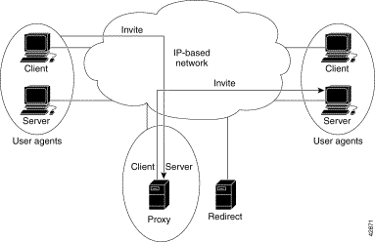
How it works …

Slide 24
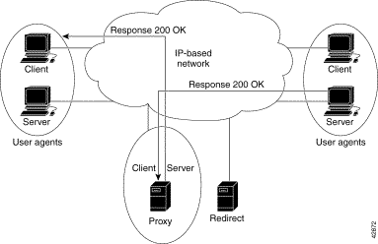
How it works …

Slide 25
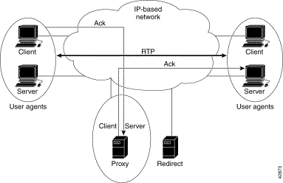
How it works …

Slide 26
Instant messaging based on SIP
SIMPLE – IM protocol based on SIP
SIP promises interoperability between various IM vendors
“Forking proxy “
SIP has unique user tracking features.
SIP addressing

Slide 27
Instant Messaging (Contd.)
SIP Redirect server
columbia.edu
2
SIP proxy
5
Location
service
3
foo.com
6
dynamic.com
4
10
11
7
1
proxy
12
8
13
9
SIP Client
SIP Client
sales.foo.com

Slide 28
Features of SIP
Simple
Similar to SMTP & HTTP
Use MIME to carry extra information
Scalable
Distributed functionality support scalability
Interoperable
Open standard
Mobility
Support using proxying & redirecting
Use of IP phones, PC, regular phones

